Slide 1
GOOD PRACTICES TRAINING FOR
BAG EMPTYING

Slide 2
PREAMBLE (FOR TRAINER)
As part of the education step in implementing the NEPSI Good Practices, NEPSI has developed a set of educational resources.
Each PowerPoint Training pack covers a topic relevant for workers across all industries that use materials containing crystalline silica. The packs provide information about the dust exposure risks related to the topic and the good practices and measures available to reduce them. The purpose of the training is to inform and educate workers to help them to use the control measures effectively and reduce their exposure to respirable crystalline silica (RCS) in the workplace.
Use the blank template and placeholders to add additional information to this training pack as needed.

Slide 3
PLEASE NOTE
The information in this PowerPoint training is advisory in nature and informational in content. It is not a standard or regulation, and it neither creates new legal obligations nor alters existing obligations created by health legislation and policy.

Slide 4

INTRODUCTION
Learning to protect yourself against work-related health hazards is a priority.
In this training, you will learn about:
The risks posed by bag emptying
Specific guidance and good practices when emptying small and bulk bags
Text for instructor to fill – if you’ve added a custom slide, insert a brief overview of the contextual material
Notes:
Excessive exposure to respirable crystalline silica (RCS) can lead to serious health problems for workers in the long-term. For that reason, it is important that all workers are aware of the good practices that limit or eliminate exposure to silica dust”.
This training provides guidance on small and bulk bag emptying for materials containing crystalline silica.

Slide 5

DUST CONTROL TECHNIQUES
GOOD HYGIENE / HOUSEKEEPING
Washing work clothes and vacuuming up dust produced by processes stops dust accumulating over time – a clean workspace is a safe one
WATER
Keeping processes wet prevents dust becoming airborne by capturing particles with water
Bag emptying processes are supported by enclosure, extraction/ventilation and PPE, which are three of the five main dust control techniques.
PROTECTIVE EQUIPMENT
PPE (e.g. Face masks) protects workers from dust when all other control measure are insufficient to control exposure risks
ENCLOSURE
Conducting RCS producing processes in a sealed environment prevents dust exposure at the source
EXTRACTION / VENTILATION
Capturing RCS at source, before we are exposed to it, and replacing contaminated air with clean air.

Slide 6


THE RISKS FROM THIS ACTIVITY
This activity can be very dusty
Long term exposure to high levels of RCS can cause disabling lung disease
It’s important that we protect ourselves from exposure to this airborne dust every day.
By following good practices today, we protect our health for the future.
How will you spend your retirement?
Notes:
Bag emptying processes and improper handling of the empty bags can lead to significant levels of dust exposure. For this reason, good practices related to bag emptying must be followed. The use of automatic or semi-automatic bag dumping stations is recommended for emptying small bags.

Slide 7

HOW BAG EMPTYING GENERATES RCS
Bag emptying causes dust to become airborne as the contents exit the bag
Rapid bag emptying generates a lot of dust, reduces air quality and potentially exposes workers to RCS
Fine, dry, powdered materials will generate the most airborne dust during handling.
This training pack covers two bag types, which require different measures to handle safely.
Notes:
Bag emptying processes and improper handling of the empty bags can lead to significant levels of dust exposure. For this reason, good practices related to bag emptying must be followed. The use of automatic or semi-automatic bag dumping stations is recommended for emptying small bags.

Slide 8
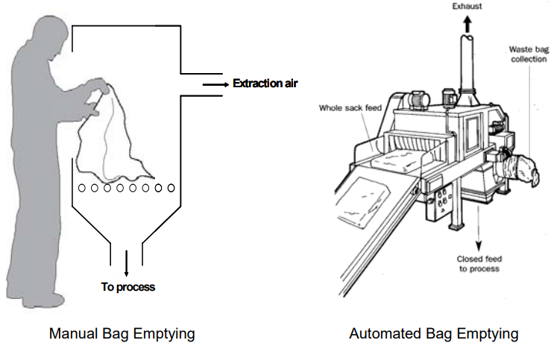
SMALL BAGS
To minimise dust generation when emptying bags:
Use automatic or semi-automatic bag emptying stations where possible.
If the process cannot be automated, it should be enclosed. Use a manual bag emptying station equipped with exhaust ventilation, if available.
Tip bag contents gently, with open end facing away.
Roll up empty bags within the extraction zone.
Wear PPE when other controls are not available.
Dispose of empty bags into a large plastic sack. Don’t let it overflow. Seal the sack before disposal.
Notes:
Though not always necessary, the use of automatic or semi-automatic bag dumping stations is recommended to reduce human error and injury.
Bag crushing creates a lot of dust. Workers should roll up empty bags within the extraction zone.
When emptying the contents of a small bag, make sure the open end is facing away. To prevent dust generation entirely, empty the bag into a large plastic sack supported and held open by a metal frame.

Slide 9
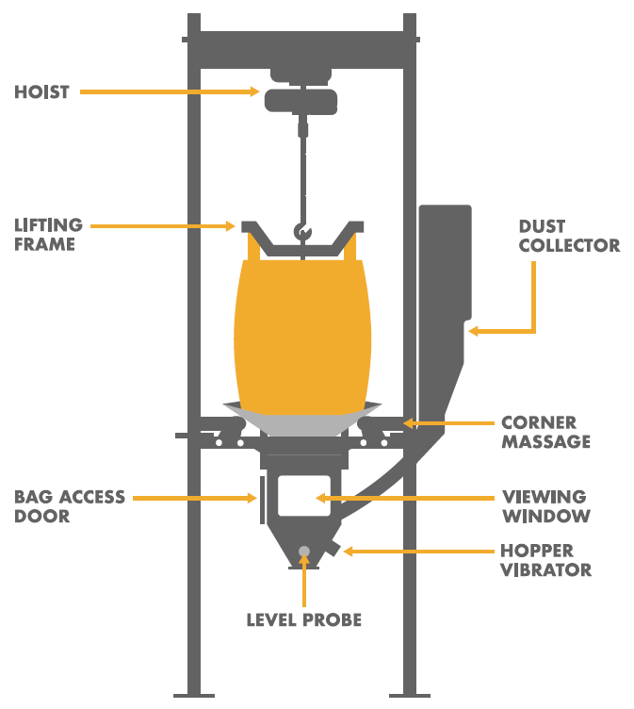
BULK BAGS (BIG BAGS)
To minimise dust generation when emptying bags:
Use automatic bag emptying stations where possible. They provide a good seal and have systems to capture dust and control the flow of material.
Use PPE when opening or cutting bulk bags manually.
Don’t manually compress the empty bags. Drop them into a large plastic sack. Don’t let it overflow. Seal the sack before disposal.
Notes:
Bulk bags are more cost-effective and environmentally than using multiple small bags. Bulk bags may contain as much material as an entire pallet of small bags. As a result, when full, they’re too heavy to be managed without machine assistance.
When emptying the contents of a bulk bag by cutting, PPE is recommended.

Slide 10

DOS AND DON’TS OF GENERAL BAG EMPTYING
DO
Make sure dust extraction systems work properly
Look for signs of damage or poor operation and report faults
Wear PPE (dust mask) if other dust controls are not available
Deal with spills immediately, using vacuum or wet cleaning
DON’T
Empty the contents of small bags too quickly
Let waste receptacles overflow
Clean up using a dry brush or compressed air
Notes:
Before starting a bag emptying process, ensure that both the ventilation and extraction systems are functioning. If you suspect there is a problem, contact the on-site manager. Be sure to check for external factors, such as draughts, that can have a big impact on ventilation systems.
When available, use handling aids to reduce human error and injury. Never overfill bags to avoid unnecessary spillages that can create additional hazards. When spills do occur, deal with them immediately by using wet or dry cleaning methods.

Slide 11
EMPTY SLIDE
Use this slide to create custom training material specific to a work environment/context.
To change the image, right click > change picture > from file.
To create more slides, click the ‘New Slide’ tab above.

Slide 12
CONCLUSION
Bag emptying can cause exposure to RCS. To protect your health, remember:
Check that ventilation and extraction systems are on (if available)
Always use machine assistance when available
Dispose of empty bags carefully to minimise dust generation
Clean up spills immediately

Slide 13
ADDITIONAL LEARNING MATERIALS
Good Practices for Bag Emptying – Small Bags (Task Sheet 2.2.1a)
Good Practices for Bag Emptying – Bulk Bags (Task Sheet 2.2.1b)
NEPSI Good Practice Guide
NEPSI Guide for SMEs
Visit the NEPSI E-Learning Platform at training.nepsi.eu for more learning resources on RCS

