Slide 1
GOOD PRACTICES TRAINING FOR
ENCLOSURE OF PROCESSES

Slide 2
PREAMBLE (FOR TRAINER)
As part of the education step in implementing the NEPSI Good Practices, NEPSI has developed a set of educational resources.
Each PowerPoint Training pack covers a topic relevant for workers across all industries that use materials containing crystalline silica. The packs provide information about the dust exposure risks related to the topic and the good practices and measures available to reduce them. The purpose of the training is to inform and educate workers to help them to use the control measures effectively and reduce their exposure to respirable crystalline silica (RCS) in the workplace.
Use the blank template and placeholders to add additional information to this training pack as needed.

Slide 3
PLEASE NOTE
The information in this PowerPoint training is advisory in nature and informational in content. It is not a standard or regulation, and it neither creates new legal obligations nor alters existing obligations created by health legislation and policy.

Slide 4
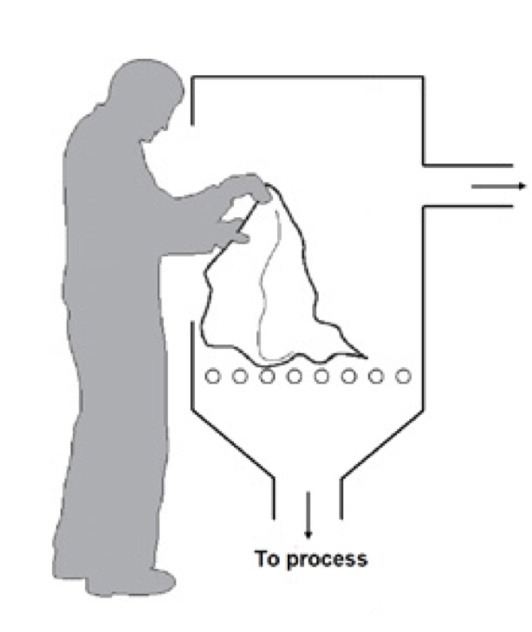
INTRODUCTION
Learning to protect yourself against work-related hazards is a priority.
In this PowerPoint training, you will learn about:
How enclosed processes reduce exposure to respirable crystalline silica dust (RCS)
Basic guidance on the enclosure of processes
Text for trainer to fill – if you’ve added a custom slide, insert a brief overview of the contextual material
Notes:
Excessive exposure to respirable crystalline silica (RCS) has serious consequences in the long-term. For that reason, it is important that all workers are aware of the best practices that limit or eliminate exposure to silica dust.
This training provides information about the enclosure of processes. Keep in mind that a risk assessment is necessary before designing any enclosed process, though this concerns primarily the management.

Slide 5

DUST CONTROL TECHNIQUES
GOOD HYGIENE / HOUSEKEEPING
Washing work clothes and vacuuming up dust produced by processes stops dust accumulating over time – a clean workspace is a safe one
WATER
Keeping processes wet prevents dust becoming airborne by capturing particles with water
Enclosure of processes is one of the five main dust control techniques.
PROTECTIVE EQUIPMENT
PPE (e.g. Face masks) protects workers from dust when all other control measure are insufficient to control exposure risks
ENCLOSURE
Conducting RCS producing processes in a sealed environment prevents dust exposure at the source
EXTRACTION / VENTILATION
Capturing RCS at source, before we are exposed to it, and replacing contaminated air with clean air.

Slide 6


THE RISKS FROM THIS ACTIVITY
The correct functioning of this equipment is essential to protect us against RCS
Long term exposure to high levels of RCS can cause disabling lung disease
It’s important that we protect ourselves from exposure to this airborne dust every day.
By following good practices today, we protect our health for the future.
How will you spend your retirement?

Slide 7

HOW ENCLOSED PROCESSES HELP REDUCE RCS EXPOSURE
An enclosed process is a method of dust control and a way to reduce dust exposure by containing or isolating the source of a dusty process.
By simply placing a barrier between the source and the workers, dust exposure levels can be significantly reduced. Enclosure can be applied to many industrial processes.

Slide 8
BASIC GUIDANCE ON THE ENCLOSURE OF PROCESSES
The enclosure of processes is one of the most effective ways to control dust:
It is always preferable to control dust at the source, rather than relying on Personal Protective Equipment (eg dust masks) for workers, which only protect the wearer and which may not always be reliable.
The use of exhaust ventilation and negative pressure can support enclosure methods. Proper ventilation of the workplace ensures good air quality and stops dust from re-entering.

Slide 9
DOS AND DON’TS OF ENCLOSURE OF PROCESSES
DO
Operate the process only when the enclosure is closed and ventilation system is running
Regularly check for damage to the enclosure and report defects
Have a plan in place to deal safely with machinery malfunctions and spillages which occur inside the enclosure
Stop the process and allow time for the air to clear before entering the enclosure
Text for trainer — Add additional text about the enclosure of processes relevant to your own context
DON’T
Enter the enclosure without following precautions against dust exposure. (eg. Personal Protective Equipment)
Operate a process with the enclosure doors open
Text for trainer — Add additional text about the enclosure of processes relevant to your own context

Slide 10
CONCLUSION
The enclosure of processes is among the most effective means of dust control. Remember:
Always use enclosed processes with ventilation systems where available — report defects
Have a plan in place to deal safely with situations where you need to enter the enclosure
Trainer to add contextual conclusions

Slide 11
EMPTY SLIDE
Use this slide to create custom training material specific to a work environment/context.
To change the image, right click > change picture > from file.
To create more slides, click the ‘New Slide’ tab above.

Slide 12
ADDITIONAL LEARNING MATERIALS
NEPSI Good Practice Guide
NEPSI Guide for SMEs
Visit the NEPSI E-Learning Platform at training.nepsi.eu for more learning resources on RCS

