Slide 1
GOOD PRACTICES TRAINING FOR
VENTILATION AND VENTILATION
SYSTEMS

Slide 2
PREAMBLE (FOR TRAINER)
As part of the education step in implementing the NEPSI Good Practices, NEPSI has developed a set of educational resources.
Each PowerPoint Training pack covers a topic relevant for workers across all industries that use materials containing crystalline silica. The packs provide information about the dust exposure risks related to the topic and the good practices and measures available to reduce them. The purpose of the training is to inform and educate workers to help them to use the control measures effectively and reduce their exposure to respirable crystalline silica (RCS) in the workplace.
Use the blank template and placeholders to add additional information to this training pack as needed.

Slide 3
PLEASE NOTE
The information in this PowerPoint training is advisory in nature and informational in content. It is not a standard or regulation, and it neither creates new legal obligations nor alters existing obligations created by health legislation and policy.

Slide 4

INTRODUCTION
Learning to protect yourself against work-related hazards is a priority.
In this PowerPoint training, you will learn about:
The three types of ventilation systems that are used to reduce workers’ exposure to respirable crystalline silica dust (RCS)
Good practices for ventilation
Text for trainer to fill – if you’ve added a custom slide, insert a brief overview of the contextual material
Notes:
Excessive exposure to respirable crystalline silica (RCS) can lead to serious health problems for workers in the long-term. For that reason, it is important that all workers are aware of the good practices that limit or eliminate exposure to silica dust.
This training provides information and guidance on general ventilation for environments that contain crystalline silica.

Slide 5

DUST CONTROL TECHNIQUES
GOOD HYGIENE / HOUSEKEEPING
Washing work clothes and vacuuming up dust produced by processes stops dust accumulating over time – a clean workspace is a safe one
WATER
Keeping processes wet prevents dust becoming airborne by capturing particles with water
Ventilation (and extraction) is one of the five main dust control techniques.
PROTECTIVE EQUIPMENT
PPE (e.g. Face masks) protects workers from dust when all other control measure are insufficient to control exposure risks
ENCLOSURE
Conducting RCS producing processes in a sealed environment prevents dust exposure at the source
EXTRACTION / VENTILATION
Capturing RCS at source, before we are exposed to it, and replacing contaminated air with clean air.

Slide 6


THE RISKS FROM THIS ACTIVITY
The correct functioning of this equipment is essential to protect us against RCS
Long term exposure to high levels of RCS can cause disabling lung disease
It’s important that we protect ourselves from exposure to this airborne dust every day.
By following good practices today, we protect our health for the future.
How will you spend your retirement?

Slide 7

HOW VENTILATION REDUCES RCS
Ventilation is used to reduce worker’s exposure to airborne dusts, including respirable crystalline silica.
The purpose of ventilation systems is to protect workers by:
Capturing airborne dust generated by work processes, before we are exposed to it
Ensuring safe air quality by replacing contaminated air with clean air
On-tool exhaust ventilation system captures dust at source
Notes:
Ventilation is an important part of maintaining indoor air quality in a work environment. A properly designed local exhaust ventilation system is one of the most effective ways to help reduce exposure to silica dust when dust generation cannot be prevented with isolation or wet methods.

Slide 8
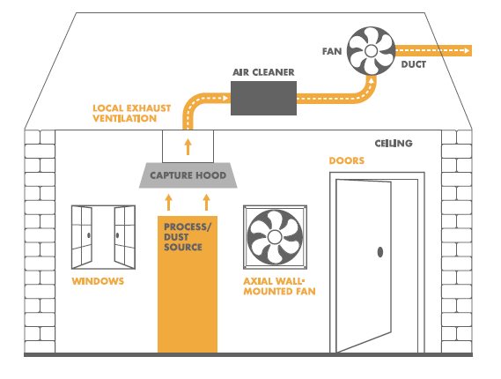
TYPES OF VENTILATION
There are three types of ventilation systems that have different functions:
Natural ventilation — (e.g. fresh air from windows, doors etc.) allows air to flow, naturally reducing the concentration of airborne contaminants
Wall-mounted fans — used to create a through-flow of air, replacing contaminated air with clean air
Exhaust ventilation — used to capture airborne dust before it reaches the workers’ breathing zone, then exhaust it in a safe way
Notes:
There are three main types of ventilation. Local exhaust ventilation is generally considered the most effective type of ventilation and should always be used when available.

Slide 9
DOS AND DON’TS OF VENTILATION
DO
Use ventilation systems when available
Report issues and faults related to ventilation systems
Text for trainer — Add additional text about general ventilation relevant to your own context
DON’T
Interfere with ventilation systems
Use portable fans that can disrupt the airflow around exhaust ventilation systems, or which may disturb settled dust and cause it to become airborne
Text for trainer — Add additional text about general ventilation relevant to your own context

Slide 10
EMPTY SLIDE
Use this slide to create custom training material specific to a work environment/context.
To change the image, right click > change picture > from file.
To create more slides, click the ‘New Slide’ tab above.

Slide 11
CONCLUSION
Ventilation is a key part of dust control and helps maintain safe levels of air quality.
Remember:
Always use ventilation systems when possible
Do not interfere with ventilation systems
If you suspect a ventilation system isn’t working correctly, contact the on-site manager

Slide 12
FURTHER LEARNING
Good Practices for General Ventilation (Task Sheet 2.1.9)
NEPSI Good Practice Guide
NEPSI Guide for SMEs
Visit the NEPSI E-Learning Platform at training.nepsi.eu for more learning resources on RCS

