Slide 1
GENERAL INTRODUCTION TO RESPIRABLE CRYSTALLINE SILICA

Slide 2
PLEASE NOTE
The information in this PowerPoint training is advisory in nature and informational in content. It is not a standard or regulation, and it neither creates new legal obligations nor alters existing obligations created by health legislation and policy.
Notes:
FAIR USE NOTICE: This document may contain copyrighted materials, the use of which has not always been specifically authorized by the copyright owner. We are making such materials available in our efforts to advance understanding of the dangers posed by Respirable Crystalline Silica (RCS).

Slide 3
PREAMBLE (FOR TRAINER)
As part of the education step in implementing the NEPSI Good Practices, NEPSI has developed a set of educational resources.
Each PowerPoint Training pack covers a topic relevant for workers across all industries that use materials containing crystalline silica. The packs provide information about the dust exposure risks related to the topic and the good practices and measures available to reduce them. The purpose of the training is to inform and educate workers to help them to use the control measures effectively and reduce their exposure to respirable crystalline silica (RCS) in the workplace.
Use the blank template and placeholders to add additional information to this training pack as needed.

Slide 4
INTRODUCTION
Learning to protect yourself against work-related hazards is a priority.
In this PowerPoint training, you will learn about:
Where crystalline silica occurs
Activities that generate Respirable Crystalline Silica (RCS)
The dangers of RCS
How to manage RCS at work
Notes:
Excessive exposure to respirable crystalline silica (RCS) can lead to serious health problems for workers in the long-term. For that reason, it is important that all workers are aware of the best practices that limit or eliminate exposure to silica dust.
This training provides basic information about respirable crystalline silica (RCS).

Slide 5
WHERE CRYSTALLINE SILICA OCCURS
Crystalline silica, in the form of the mineral quartz, is found in several materials, such as:
Quartzite: Greater than 95%
Sand: Greater than 90%
Sandstone: Greater than 90%,
Flint: Greater than 90%
Gritstone: Greater than 80%
Shale: between 40–60%
Slate: up to 40%

Slide 6

PROCESSES THAT GENERATE DUST
When materials containing crystalline silica are put through different high-energy industrial processes, fine air-borne dust is generated, which is called Respirable Crystalline Silica (RCS). Processes include:
Cleaning
Transporting
Bagging
Packing
Crushing
Grinding
Drying
Shaping
Mixing
Cutting
Sawing
Drilling (list not exhaustive)

Slide 7
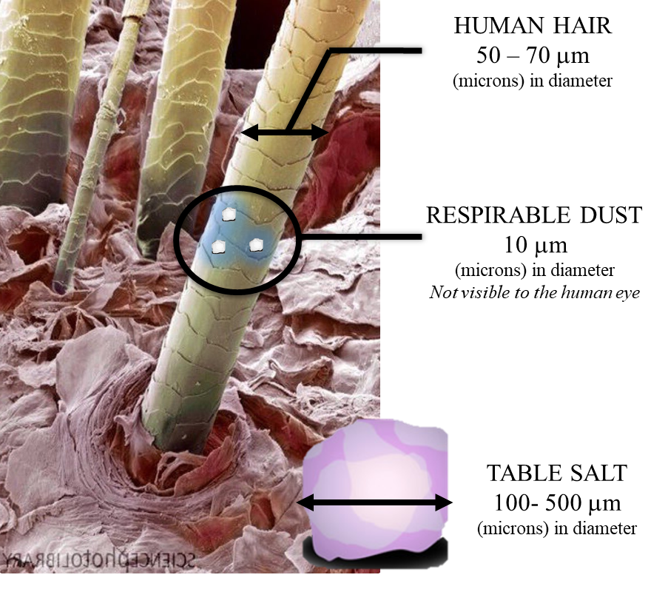
SILICA — A HEALTH
HAZARD
When materials containing crystalline silica are used in high-energy processes (such a sawing or drilling), particles are released in the form of very fine respirable dust (RCS), which is invisible to the naked eye even at high concentrations.
RCS is a serious hazard to workers’ health.

Slide 8
RCS AND SILICOSIS
Frequent and excessive exposure to RCS (usually over many years) is shown to cause silicosis and lung cancer:
Silicosis is developed by breathing in fine dust particles in the lungs, which lead to chronic breathing difficulties later in life and, in some cases, death.
There are different stages of silicosis, from “simple silicosis” to “progressive massive fibrosis” (PMF).
Epidemiological studies show that the incidence of lung cancer has increased especially in workers with silicosis.
Healthy lungs
Lungs affect by PMF

Slide 9

MINIMIZING EXPOSURE TO RCS
The risk of developing a lung disease is entirely preventable when control measures and good practices are applied.
We follow the NEPSI Good Practices, which have four main steps:
Risk Assessment: Assessing the risk of exposure
Control: Deciding how to control and prevent exposure
Monitoring: Monitoring the effectiveness of control measures
Education: Providing information, instruction and training
NEPSI is the acronym for the “European Network for Silica” formed by the Employee and Employer European sectoral associations having signed the Social Dialogue “Agreement on Workers' Health Protection Through the Good Handling and Use of Crystalline Silica”

Slide 10

DUST CONTROL TECHNIQUES
GOOD HYGIENE / HOUSEKEEPING
Washing work clothes and vacuuming up dust produced by processes stops dust accumulating over time – a clean workspace is a safe one
WATER
Keeping processes wet prevents dust becoming airborne by capturing particles with water
There are five main dust control techniques that are used to manage RCS, which are part of the NEPSI Good Practices.
PROTECTIVE EQUIPMENT
PPE (e.g. Face masks) protects workers from dust when all other control measure are insufficient to control exposure risks
ENCLOSURE
Conducting RCS producing processes in a sealed environment prevents dust exposure at the source
EXTRACTION / VENTILATION
Capturing RCS at source, before we are exposed to it, and replacing contaminated air with clean air.

Slide 11
RCS PROTECTION MEASURES WE USE
Placeholder for trainers to include information about the protection workers need to employ at this site (e.g. switch on ventilation systems, use PPE etc.)
*Consider including photos*

Slide 12
CONCLUSION
RCS is an occupational hazard that can lead to life-changing health issues, such as silicosis and cancer. Remember:
RCS is a serious risk to workers’ health
Exposure risks are entirely preventable by applying appropriate control measures
Control measures must be present, maintained and used in the workplace
Trainer to add contextual conclusions

Slide 13
EMPTY SLIDE
Use this slide to create custom training material specific to a work environment/context.
To change the image, right click > change picture > from file.
To create more slides, click the ‘New Slide’ tab above.

Slide 14


REMEMBER
Long term exposure to high levels of RCS can cause disabling lung disease
It’s important that we protect ourselves from exposure to this airborne dust every day.
By following good practices today, we protect our health for the future.
How will you spend your retirement?

Slide 15
ADDITIONAL LEARNING MATERIALS
NEPSI Task Sheets
NEPSI Good Practice Guide
NEPSI Guide for SMEs
Visit the NEPSI E-Learning Platform at training.nepsi.eu for more learning resources on RCS

