Slide 1
GOOD PRACTICES TRAINING FOR
PERSONAL PROTECTIVE
EQUIPMENT (PPE)

Slide 2
PREAMBLE (FOR TRAINER)
As part of the education step in implementing the NEPSI Good Practices, NEPSI has developed a set of educational resources.
Each PowerPoint Training pack covers a topic relevant for workers across all industries that use materials containing crystalline silica. The packs provide information about the dust exposure risks related to the topic and the good practices and measures available to reduce them. The purpose of the training is to inform and educate workers to help them to use the control measures effectively and reduce their exposure to respirable crystalline silica (RCS) in the workplace.
Use the blank template and placeholders to add additional information to this training pack as needed.

Slide 3
PLEASE NOTE
The information in this PowerPoint training is advisory in nature and informational in content. It is not a standard or regulation, and it neither creates new legal obligations nor alters existing obligations created by health legislation and policy.

Slide 4
INTRODUCTION
Learning to protect yourself against work-related hazards is a priority.
During this training you will learn:
What personal protective equipment (PPE) is and how it can help to minimise our exposure to harmful RCS
When and how to wear PPE
Best practices for using PPE
Text for trainer to fill – if you’ve added a custom slide, insert a brief overview of the contextual material
Notes:
Excessive exposure to respirable crystalline silica (RCS) can lead to serious health problems for workers in the long-term. For that reason, it is important that all workers are aware of the best practices that limit or eliminate exposure to silica dust.
This PowerPoint training covers the correct use of personal protective equipment (PPE) for workers exposed to respirable crystalline silica (RCS) dust.

Slide 5

DUST CONTROL TECHNIQUES
GOOD HYGIENE / HOUSEKEEPING
Washing work clothes and vacuuming up dust produced by processes stops dust accumulating over time – a clean workspace is a safe one
WATER
Keeping processes wet prevents dust becoming airborne by capturing particles with water
PPE is one of the five main dust control techniques.
PROTECTIVE EQUIPMENT
PPE (e.g. Face masks) protects workers from dust when all other control measure are insufficient to control exposure risks
ENCLOSURE
Conducting RCS producing processes in a sealed environment prevents dust exposure at the source
EXTRACTION / VENTILATION
Capturing RCS at source, before we are exposed to it, and replacing contaminated air with clean air.

Slide 6

TYPES OF PPE
Earmuffs
Helmet
Goggles
Mask / respiratory protective equipment
Overalls
Jacket
Boots
Gloves
Notes:
PPE is any item of protective clothing or equipment designed to protect the wearer's body from injury or infection.
While PPE should be available at all sites, its use should be a last resort when all control measures have been tried and failed to provide sufficient control of dust exposure.

Slide 7

WHY USE PPE?
PPE is used to protect its user against physical harm and hazards in the workplace, including respirable crystalline silica dust
Using PPE (when necessary) is important because it is a preventative measure in risk control
Respiratory protective equipment helps to minimise our exposure to harmful respirable crystalline silica dust (RCS)

Slide 8


THE RISKS FROM THIS ACTIVITY
The correct functioning of this equipment is essential to protect us against RCS
Long term exposure to high levels of RCS can cause disabling lung disease
It’s important that we protect ourselves from exposure to this airborne dust every day.
By following good practices today, we protect our health for the future.
How will you spend your retirement?

Slide 9
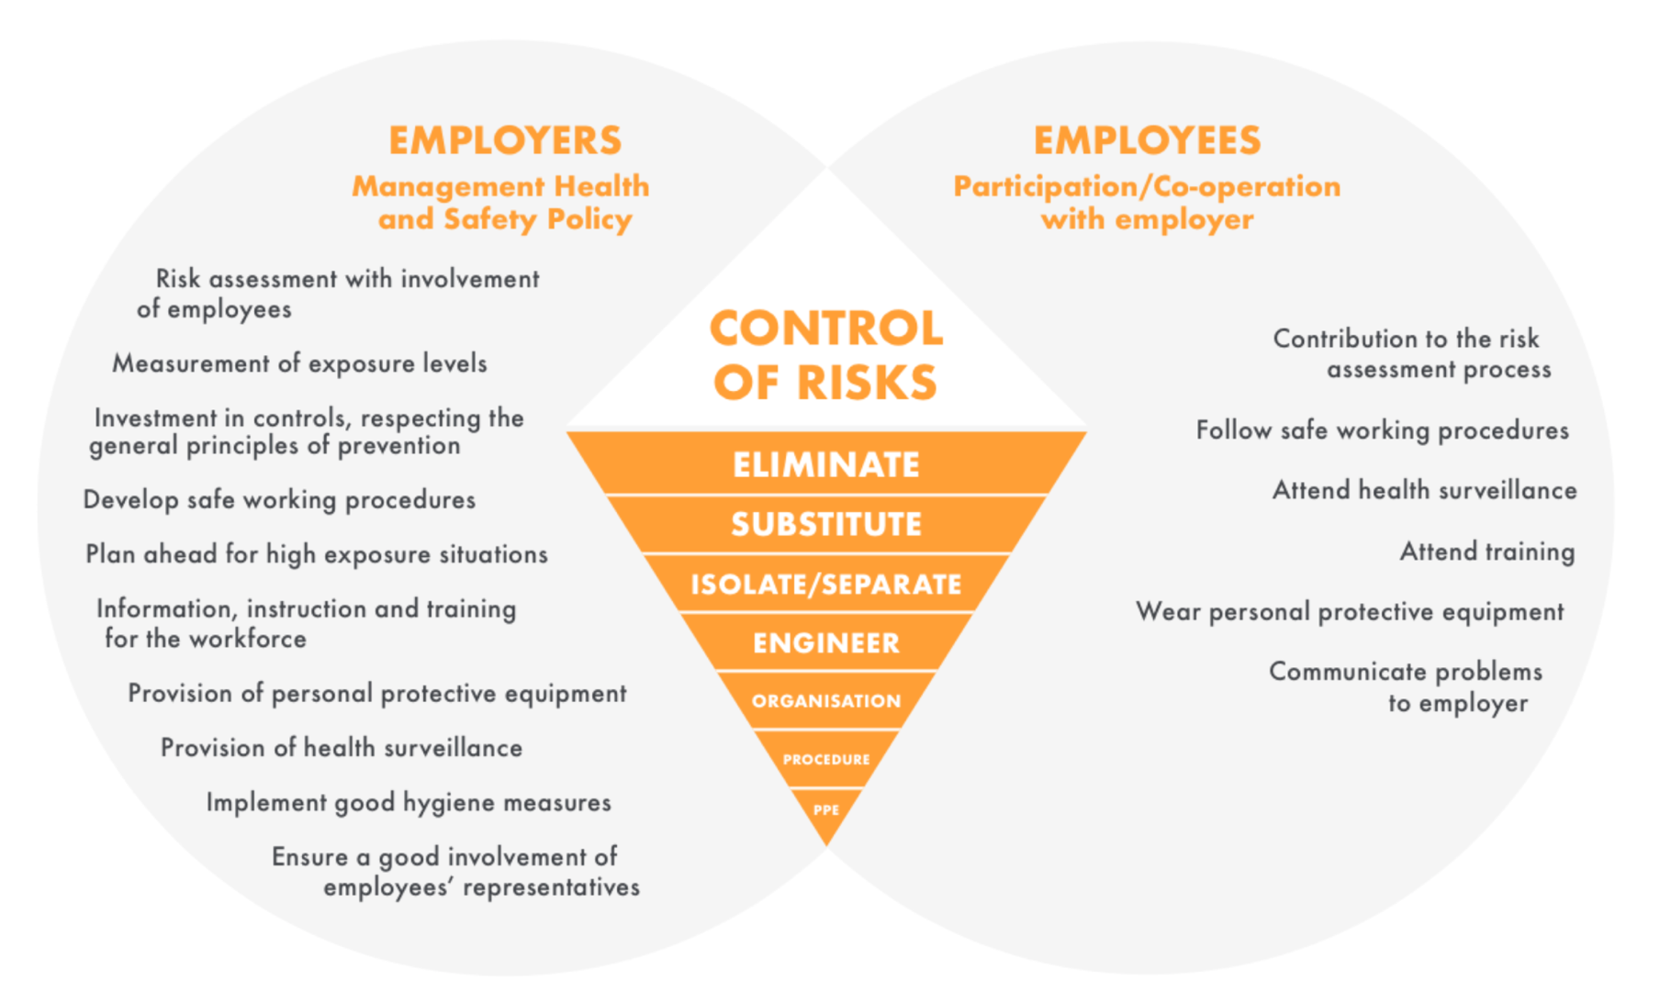
HIERARCHY OF RISK CONTROL
Because PPE only protects the wearer, and because it can be misused or damaged, it is not entirely reliable.
Workers should only wear PPE when prompted to and as a last resort when other controls are not sufficient.
Notes:
The following diagram summarises the risk management process, from the perspective of both employer and employee, when applied to control of respirable crystalline silica. The health and safety systems implemented in the companies must be respected by both employer and employee.

Slide 10
WHAT PPE DO WE USE?
Text for trainer — Insert information about PPE related to your specific working context.
Notes:
PPE should only be worn when given specific instructions to and should be selected on the basis of performance (e.g. protection factor), comfort and durability.
Tasks that require the use of PPE will be indicated with appropriate signage and pictograms.
Protective clothes (overalls) must be used during all dusty tasks. Dark-coloured overalls may be used to help indicate dust contamination.

Slide 11
CHECKING FOR DAMAGE
Before equipping PPE, check for damage such as:
Tears
Rips
Spills
Cracks, impacts (helmets, masks, goggles, toe caps)
Replace damaged PPE immediately.
(overalls, gloves, boots)
Notes:
Once it has been confirmed that PPE is necessary for the task at hand, workers should ensure that their item is free from damage or excessive wear and tear.
Damaged PPE puts workers at unnecessary risk. If an item is used on a regular basis, or is shared among the workforce, damage is likely to occur after multiple and extended uses.
As soon as PPE is damaged, it should be replaced immediately.

Slide 12
CORRECT USAGE
When equipping PPE, ensure that it:
Fits the wearer properly
Does not compromise the wearer’s ability to carry out the task safely (e.g. overly restricted eyesight)
Is compatible with additional items of PPE
Notes:
Wearing PPE may not be a comfortable experience, but it’s important to ensure it’s being worn correctly.
Items such as masks, goggles and helmets need to be adjusted to fit the size of the wearer.
When wearing multiple items of PPE (such as a dust mask and a welding visor), ensure that they are compatible.
Be aware also of other factors that may reduce the effectiveness of PPE, such as facial hair. Operators with facial hair should use air fed respirator to avoid dust entering the mask.

Slide 13
AFTER USE
Where available, use facilities such as air showers to remove dust from PPE safely
Store dirty clothes and equipment in designated facilities
Do not take dirty PPE home
Replace PPE according to the manufacturer's instructions
Notes:
After use, PPE should be cleaned (if necessary) and stored in an appropriate facility. PPE, such as clothes, should be cleaned by the employer.
Never in any circumstances should PPE be taken home.

Slide 14

FILTERS
Dust masks and filters are usually classified as FFP1, FFP2 and FFP3.
As respirable crystalline silica dust (RCS) is considered high-risk, harmful dust, be sure to use FFP2 or FFP3 class dust masks with filters, or N95 filters or higher, according to your risk assessment.
The classification of a mask will be shown on its label

Slide 15

CLEANING CLOTHES
To avoid unnecessary exposure to dust, always use appropriate cleaning equipment when available.
Notes:
The following shows good practices related to cleaning PPE. Next to the video picture you see a graph and a red bar illustrating the dust concentration in mg/m3.
The measurement of the dust concentration is not about respirable crystalline silica, it is based on a semi-quantitative measurement. What is essential is not the dust concentration value but the relative difference between exposure levels during the recommended practice and other practices.

Slide 16
DOS AND DON’TS OF PPE
DO
Follow the manufacturer’s instructions
Ensure the items of PPE fit correctly. Respiratory protective equipment must not be compromised by facial hair.
Check that PPE items are compatible when used in combination
Clean reusable PPE after use and when necessary, storing it in a designated clean place
Keep dirty overalls separate to clean clothes and get them washed regularly
DON’T
Use any PPE that is broken or excessively worn
Use PPE unnecessarily. Some PPE can restrict the wearer’s ability to complete a task safely.
Take PPE home

Slide 17
CONCLUSION
There are 3 easy steps to remember when using PPE:
Check PPE for signs of damage
Ensure PPE is correctly fitted (and that respiratory protective equipment is not compromised by facial hair)
After use, store PPE in an appropriate clean area
Trainer to add contextual conclusions
Notes:
PPE should only be used as a last resort, when all over control measure are insufficient to control dust exposure. When PPE is necessary, its use should be controlled and monitored.

Slide 18
EMPTY SLIDE
Use this slide to create custom training material specific to a work environment/context.
To change the image, right click > change picture > from file.
To create more slides, click the ‘New Slide’ tab above.

Slide 19
FURTHER LEARNING
Good Practices for Personal Protective Equipment (Task Sheet 2.1.15)
NEPSI Good Practice Guide
NEPSI Guide for SMEs
Visit the NEPSI E-Learning Platform at training.nepsi.eu for more learning resources on RCS

